Slide 1
ODP Qualification Support Guide
1

Slide 2
Contents
Getting Started
Step by Step Login Guide
Assessments Level 2/3
Remote Invigilation (including Candidate/Invigilator’s Guide – level 3/4)
Level 4-7
Referencing
How to upload a completed task/How to upload an amended task
Submission Checklists Referrals
Support
2

Slide 3
Getting Started
Additional content here
Don’t procrastinate - make a start on your qualification as soon as possible after registration. Keep going even if you only have time to do an hour a week.
As Mark Twain once said, “If its your job to eat a frog, its best to do it first thing in the morning. And if its your job to eat two frogs, eat the biggest one first...”
Eating the frog means to just do it, otherwise the frog will eat you,
meaning you’ll end up procrastinating the whole day.
3

Slide 4
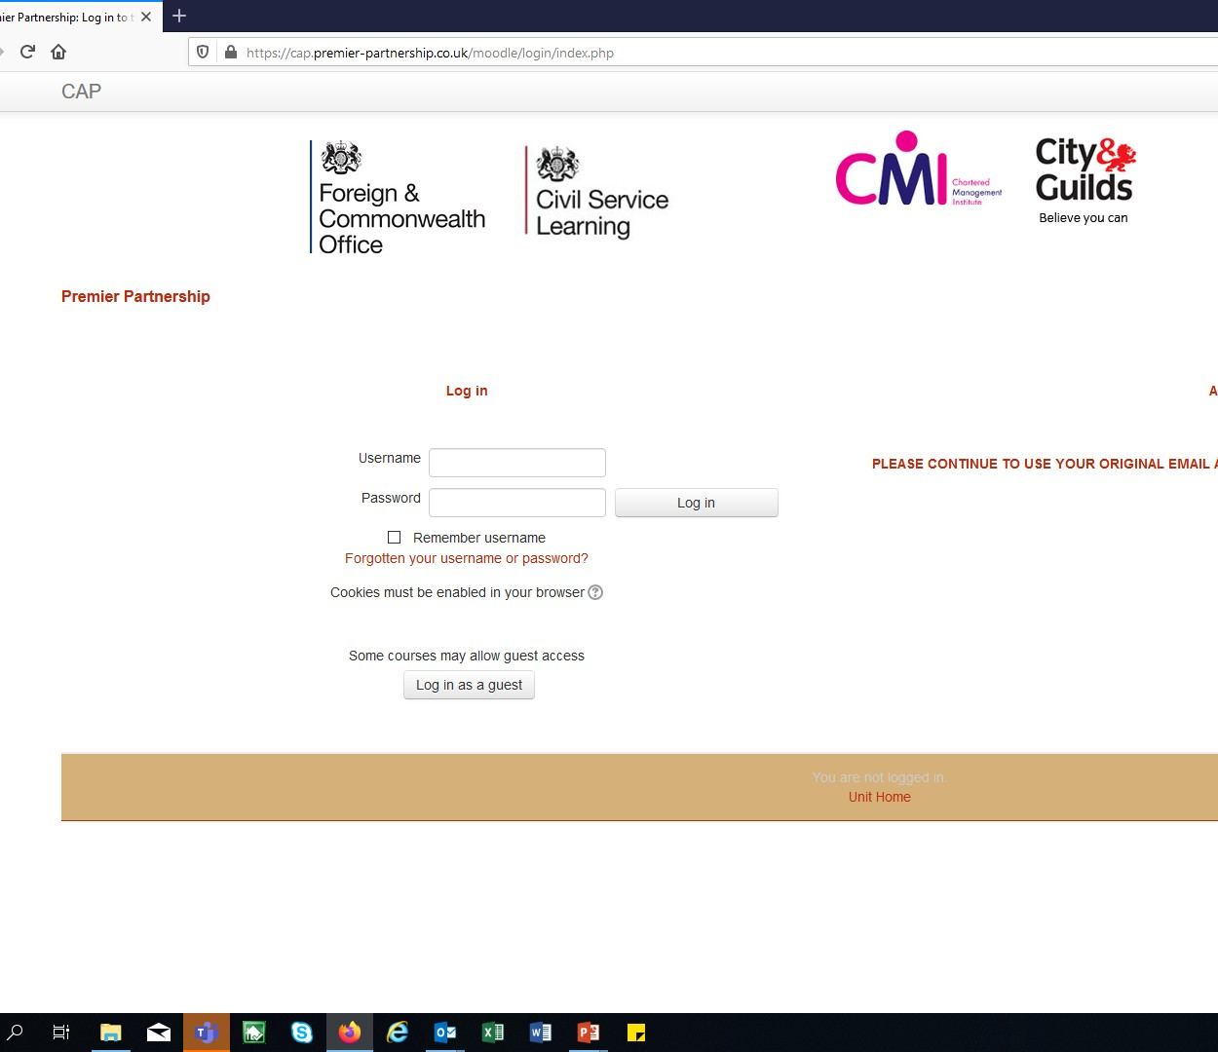
Login to the Premier Partnership (Moodle) Website: https://cap.premier- partnership.co.uk/moodle/login/index.php
You will have received an email from Premier Partnership following registration containing your login and password details
Keep these details safe as you will need them every time you access your qualification on the website (known as the Moodle site)
Your username is your work email address
Use the password included in the email above

Slide 5
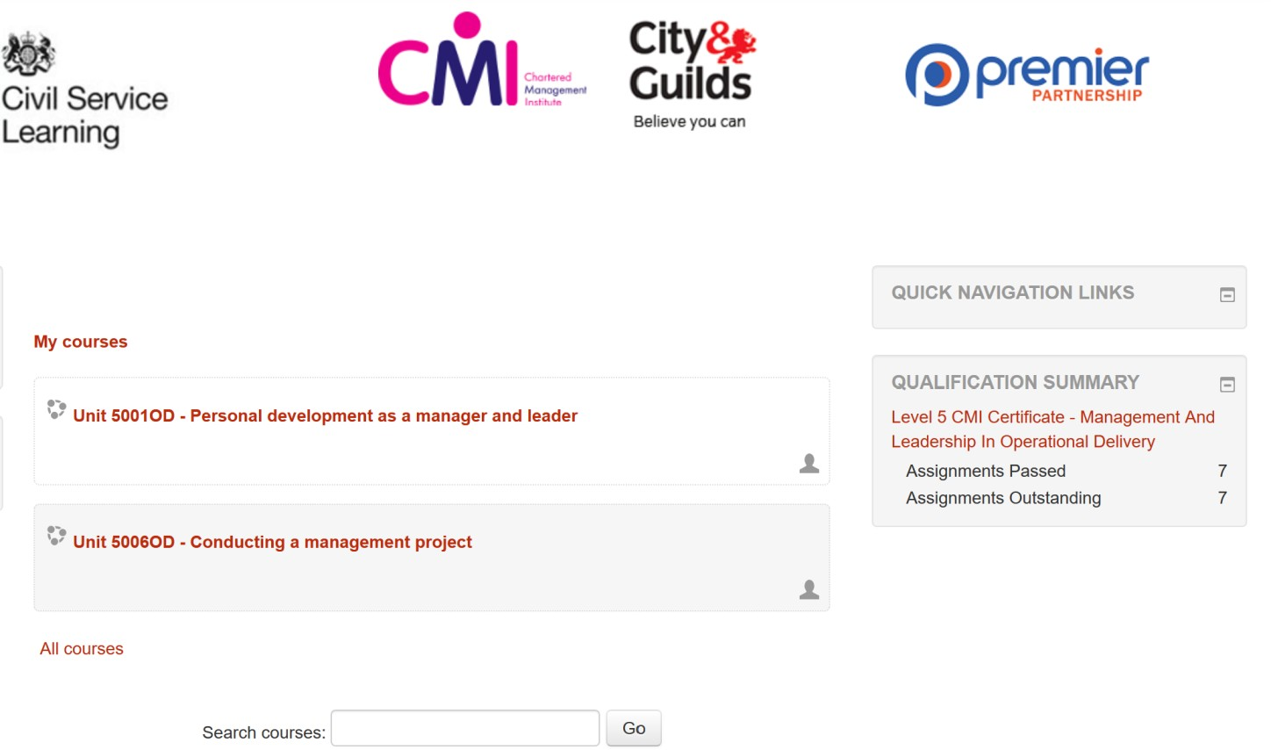
The Home Page
On this page you will see your OWN course details and chosen units
The qualification summary shows how many assignments have been passed and what’s outstanding
Please be aware the qualification summary updates within 24 hours of receiving a task pass and so will not update as soon as you receive your automated email from the assessor with your result.
Please log into your account the following day to view the update on this.
5

Slide 6
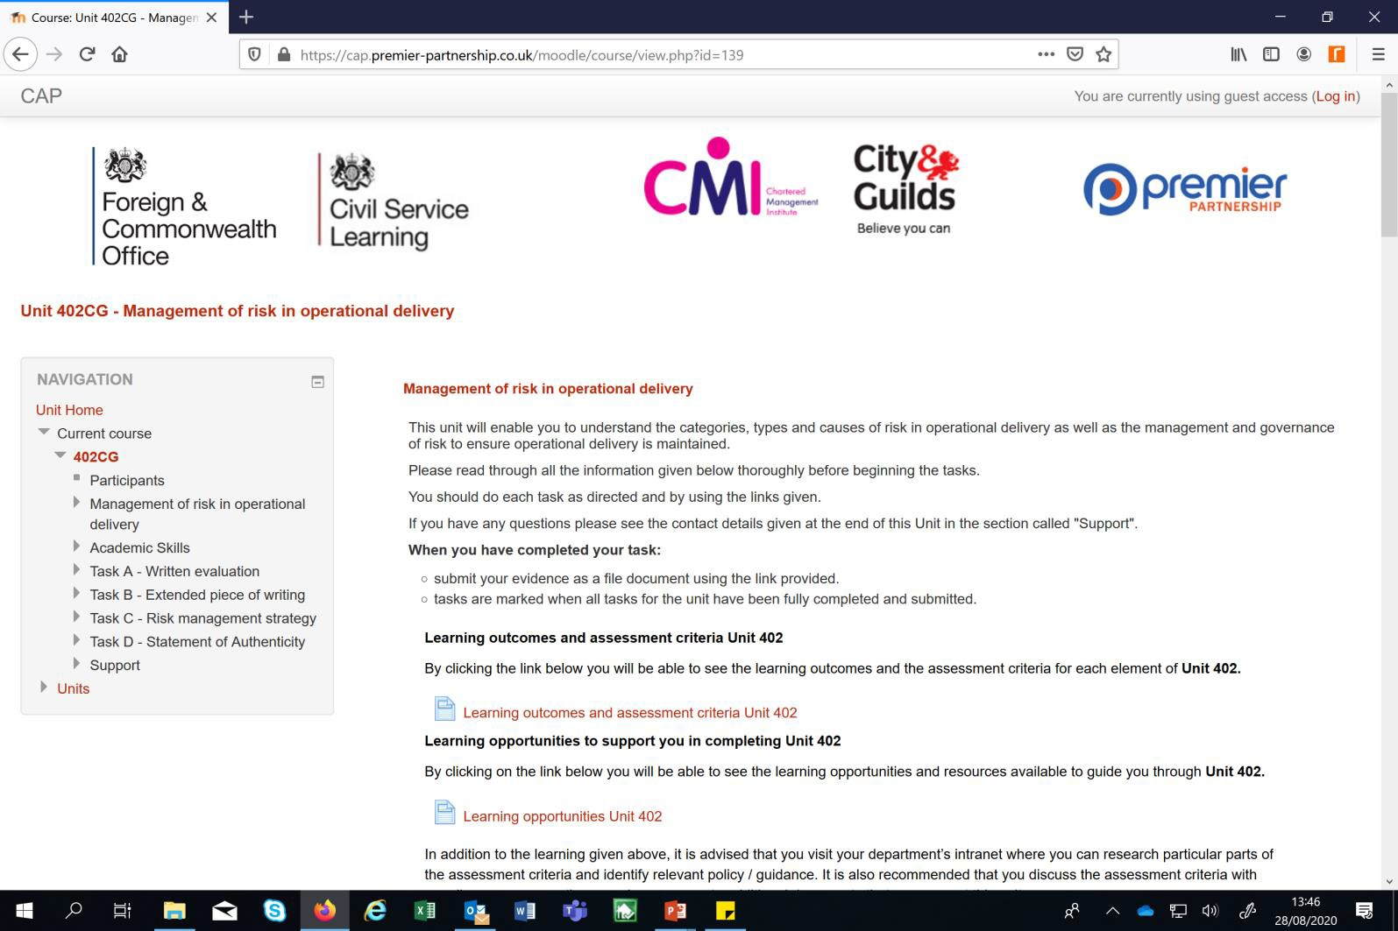
Unit Homepage
For each Unit this is the home page:
Where you will find a list of the
tasks
This is the Learning Outcomes and Assessment Criteria - this is what your test or assignment will be assessed against
Here you will find the Learning Opportunities:
Links to eLearning
Articles/Guides
6

Slide 7
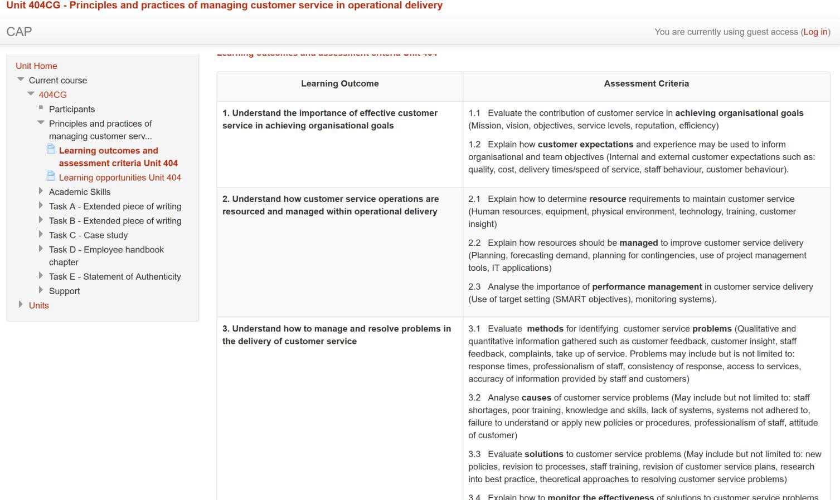
Learning Outcomes and Assessment Criteria
The Learning Outcomes confirm what you will learn from studying the qualification unit
It is vital for you to read and understand the Assessment Criteria to help you pass your tasks. Paying particular attention to the words in bold will also help
It’s a good idea to keep referring back to the Assessment Criteria throughout your studies, to not only prepare and revise for an assessment but also to help you whilst completing it as well. Use the Assessment Criteria as a revision checklist to ensure you are prepared and have all the key points covered
This document provides tips on suggested answers as the Assessment Criteria is what you will be assessed against
7

Slide 8
Qualification Levels 2 and 3 – Online Assessments
8

Slide 9
Level 2 Assessments
What to expect:
You will sit a multiple choice test for each unit, which is carried out online and under exam conditions (for example classroom style, usually with your line manager acting as invigilator). Note remote invigilation is currently not available for Level 2.
There is more than one version of the test, which is generated for you on the day of the test
The invigilator will receive a password to enable you to access your on-line
test on the day of your assessment
Once you enter the password on the system, the test will begin. In the top corner of the screen a clock will appear, which lets you know how much time you have left to complete the test
When the time is up, your paper will automatically be submitted for marking
and you will no longer be able to amend it
If you complete the test before the time is up, you will still be able to submit your test
Pass/fail results are instant, so you will know your result as soon as your test is complete
Important - You will need to access the Premier Partnership website to complete your assessment, please make sure you have a note of your login details
9

Slide 10
Level 3 Assessment
What to expect:
You will sit a short answer test for each unit, which is carried out online and under exam conditions (either classroom style or remote invigilation – usually with your line manager acting as invigilator). Note that remote invigilation is available for Level 3 and 4 examinations.
There is more than one version of the test, which is generated for you on the
day of the test
The invigilator will receive a password to enable you to access your on-line test on the day of your assessment
Once you enter the password on the system, the test will begin. In the top corner of the screen a clock will appear, which lets you know how much time you have left to complete the test
When the time is up, your paper will automatically be submitted for marking and you will no longer be able to amend it
If you complete the test before the time is up you will be able to submit it
Marking of your test can take up to 6 weeks and your result will show on the Moodle Platform in the qualification summary box, this will not be sent to you via email from Premier Partnership
Important - You will need to access the Premier Partnership website to complete your assessment, please make sure you have a note of your login details

Slide 11
Remote Assessments
Background: Since the COVID 19 pandemic and colleagues working from home limiting the ability to invigilate tests for both Levels 3 and 4, it has been necessary to source a solution to enable remote invigilation to take place.
Therefore, the attached checklists and guidance have been produced to support a remote invigilation process.
Both the invigilator and candidate must read the relevant guidance and checklists before booking a remote test.
It is essential that all the guidance is followed exactly as stated in the guides and checklists, as incorrect administration of the regulations is considered by City & Guilds as maladministration and could lead to remote tests becoming null and void.

Slide 12
Check Lists - to be completed, signed and dated on the day of the test
Remote Invigilation – Invigilators Checklist
Remote Invigilation – Candidate Guidance
When | Task | Check
When booking the assessment | Email the Assessment Guide to the candidate Read the Invigilator Guidance Arrange a practice run with the video technology, so you’re ready to go on the day | ☐
Security Checks Before the assessment | 1. Confirm the identity of the candidate if not known to the invigilator, with photo ID, such as Civil Service pass, driving license or passport | ☐
 | 2. View the candidate’s room (including immediate desk area and floor space) to ensure no additional equipment/devices are available, other than the laptop and second device they are using for the assessment to take place. | ☐
 | 3. Check that any wall charts/notes have been cleared from the walls and any notebooks have been removed from the room | ☐
 | 4. Ask the candidate to show their screen, as proof that only one screen is open on their system | ☐
Before starting the assessment | The invigilator should ask the candidate to confirm they understand the requirements of the test and that they are now under exam conditions Inform the candidate how much time they have for the assessment Re-affirm that the candidate is not permitted to leave the room and no other person should enter the room during the assessment | ☐
 | Provide the candidate with the password and remind the candidate to complete the relevant details such as name, candidate number etc., on the assessment form Instruct the candidate to start when ready | ☐
During the assessment | 10. Supervise the candidate at all times and you must not carry out any other tasks when invigilating | ☐
 | 11. Note any actions considered as malpractice and address the issues with the candidate if appropriate | ☐
After the Assessment | 12. If the candidate finishes the assessment before the allotted time allowed and wishes to end the assessment early, ask them to show their screen so you can see the paper has been submitted for marking | ☐
 | 13. Confirm the next steps such as the expected marking times | ☐
 | 14. If any malpractice notes made, submit these to the service providers – Premier Partnership | ☐
When | Task | Check
Prior to your assessment date | Read the assessment guide – for candidates Choose a comfortable room for your assessment, where you will not be disturbed | ☐
Security Checks | 3. Have photo ID ready to show the invigilator, such as Civil Service pass, driving license or passport | ☐
 | 4. Ensure all note books are removed from the room/Check that any wall chart/notes have been cleared from the walls | ☐
 | 5. Only have the one screen open on your computer to take your assessment | ☐
 | 6. Ensure that the room door can be viewed by the invigilator throughout the assessment | ☐
Before the Assessment | Make sure you have everything in the room that you require, laptop charger, a drink etc., as you will not be permitted to leave the room while the assessment is underway You will need to login to the Premier Partnership website to access your assessment, please make sure you have a note of your login details | ☐
 | 9. Listen to the invigilators instructions and enter the password provided when you are ready to start the assessment | ☐
 | 10. Remember to enter your personal details on the on-line assessment paper | ☐
During the Assessment | 11. No-one should enter the room and you should not leave the room. | ☐
 | 12. You should not open another screen on your computer or use your second device for any other reason than allowing the invigilator to view the assessment | ☐
 | 13. If you finish the assessment before the allotted time allowed and wish to end the assessment early, inform your invigilator as they will need to see you submit the paper online by clicking the finish button | ☐
After the assessment | 14. Your invigilator will confirm the next steps such as the expected marking times and will end the invigilation process | ☐
When
Task
Check
Candidate Details:
Invigilators Details
Name: | Signature: | Date:
Name: | Signature: | Date:
V. 1 August 2020
V. 1 August 2020
OFFICIAL
OFFICIAL

Slide 13
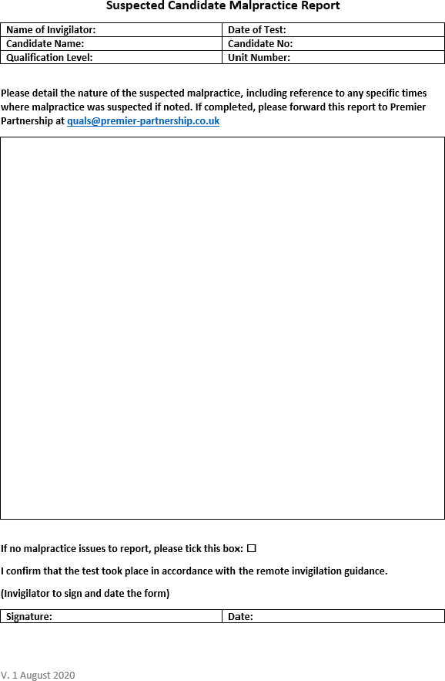
Malpractice Report – must be completed for all remote invigilation
After the test:
The invigilator must email a copy of all the forms to quals@premier-partnership.co.uk
This section of the form must be completed in full for all cases
Where no malpractice has taken place –
tick the box to confirm this
Don’t forget to sign and date the form
Must be completed for all cases

Slide 14
Assessment
Guide
For Candidates

Slide 15
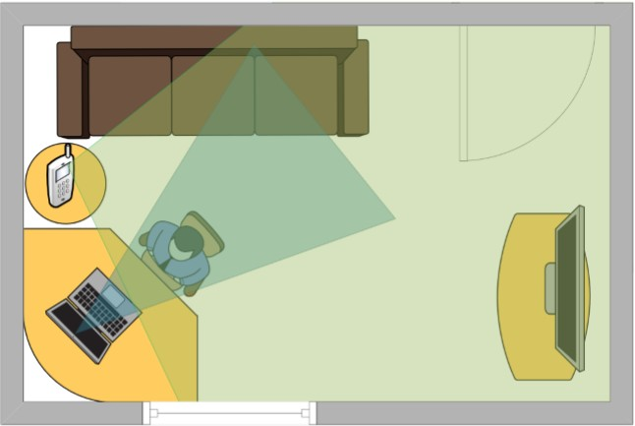
Preparing for your remote assessment This is only appropriate to remote invigilated exams for Level 3 and Level 4.
When sitting the test, the candidate must have both the computer and the mobile phone/tablet cameras switched on throughout. The two devices should be positioned in such a way that:
The computer camera shows the candidate and their upper torso
as much as is possible in a front-on view.
The mobile phone/tablet camera should be positioned at a wider angle so that it shows the candidate in profile and also gives an unimpeded view of as much of the room as is possible
Prior to your assessment day - arrange with your invigilator to have a practice run with the video technology so your ready to go on the day
You will need to decide beforehand on the technology you will use on the day that supports video conferencing, e.g. Microsoft Teams, Skype for Business, Go to Webinar, Zoom etc.
Make sure you know your login details and password for the Premier Partnership website

Slide 16
Preparing for your Face to Face Assessment
01
Make sure you know your login details and password for the Premier Partnership website
02
Make a note of the room number where you are sitting the assessment
03
Arrive at least 15 minutes before the start of your test, so you can grab a drink of water, set up your computer and listen to the invigilators guidance
04
Don’t take any notes or your mobile phone in the room with you
05
Remember to take your laptop charger if using your own device06
Version .4 - June 2021

Slide 17
Top Tips –Your Assessment
Read all the questions carefully
Try and give an answer to every question
Remember if the questions carry different marks, and you are struggling with a question worth 1 mark, move on and come back to it later, as there may be a question further along worth 3 marks that you can answer
At the start of the exam, ask your invigilator to keep a check of the time and remind you at regular intervals how much time you have left, it’s amazing how quickly the time goes and your too busy to notice
If you finish early and have spare time, read through your answers again to see if you can improve on what you have written. Check that you have not missed any questions
Keep calm, if your feel a bit nervous, take a deep breath and don’t start your exam until you feel
composed and ready
Once you start you will be in exam conditions, so this means you won’t be able to take a break half way through or ask any questions at this stage
Reasonable adjustments can be considered so please make sure you discuss this with your
line manager and training provider ahead of booking your exam

Slide 18
Invigilator Guidance – Remote Invigilation This is only appropriate to remote invigilated exams for Level 3 and Level 4.
Role of the invigilator
The role of the invigilator is to ensure that examinations are conducted in accordance with regulatory requirements listed below and the invigilation checklist.
PLEASE NOTE: remote invigilation must be carried out on a 1 to 1 basis; multiple candidate invigilation can only take place face to face.
As the length of the tests can range between one to two hours, it is advisable to invigilate no more than two tests per day with a gap in between for a break as the invigilation process can be quite intense.
Add an extra 30 minutes onto the exam time, for completing the checklists and setting up the video.

Slide 19
Invigilator Guidance – Remote Invigilation
Ofqual have agreed that remote invigilation will be a permanent option for Level 3 and Level 4 examinations in Operational Delivery.
To Book
Anyone wishing to sit their unit test remotely should continue to email quals@premier-partnership.co.uk at least 72 hours in advance of the test.
In the title of the email they must state, Remote Invigilation Test. Please confirm in the email that they are completing the assessment remotely, giving the unit number, the invigilator name and email address.
Once Premier have acknowledged this email, they will then inform the learner to complete the test booking form as they would with all test bookings. (The test password will only be generated if the booking is made using the form) This allows Premier Partnership to track the details of the learners who are completing their assessments remotely, before the booking is made.
Learners can still choose to sit their test via face-to-face invigilation and normal procedures apply.

Slide 20
Invigilator Guidance – Remote Invigilation
Prior to the test
Arrange a practice run with the candidate to test the video technology so you are both clear on how to proceed on the day. Read through the invigilation check list and send the candidate a copy of the candidate assessment guide. The day before the test make sure have received notification of the test password from Premier Partnership, as the candidate will need this to access the test.
On the day of the test
Ensure you have a copy of the invigilator’s checklist and the candidate’s checklist. Both lists should be completed before the test takes place and signed and dated. Make sure you have a note of the test password, so the candidate can access the online assessment.
PLEASE NOTE: it is not necessary for the invigilator to share their video whilst the test is progress as it can be distracting for the candidate.

Slide 21
Invigilator Guidance – Remote Invigilation
During the test
The invigilator must:
Just before the test make sure you and the candidate set your Skype/Teams notification response to do not disturb – to avoid any interruptions
Be able to observe the candidate at all times as well as the door to the room
If malpractice is suspected – you must complete the malpractice form that accompanies the checklist noting details of any suspected malpractice including reference to any specific times where malpractice was suspected
It may be necessary to stop the test if malpractice is suspected, please refer to the malpractice guidance or FAQ’s
If you are unable to complete the test, due to IT issues, please contact quals@premier-partnership.co.uk
The invigilator must not:
Carry out any other task (for example, reading a book, using a computer, mobile phone etc)
whilst the test is in progress

Slide 22
Invigilator Guidance – Remote Invigilation
After the test
The invigilator must:
Ensure all the checklists have been fully completed, signed and dated by the relevant parties
The malpractice form has been completed or the correct box has been ticked to show no malpractice was recorded. This form must be signed and dated by the invigilator
The invigilator must send copy of all the forms to quals@premier-partnership.co.uk
If you are unable to complete the test, due to IT issues, please contact quals@premier-partnership.co.uk

Slide 23
Invigilator Guidance – Remote Invigilation
Guidance on using the technology
You will need to decide prior to the assessment, the technology you will use on the day that supports video conferencing, e.g. Microsoft Teams, Skype for Business, Go to Webinar, Zoom etc.
When sitting the test, the candidate must have both the computer and the mobile phone/tablet cameras switched on. The two devices should be positioned in such a way that:
The computer camera shows the candidate and their upper torso as much as is possible in a front-on view
The mobile phone/tablet camera should be position at a wider angle so that it shows the candidate in profile and also gives an unimpeded view of as much of the room as is possible, including the room door
Remember to set your notifications to do not disturb to avoid any interruptions

Slide 24
Invigilator Guidance – Remote Invigilation
Example of the room layout

Slide 25
Qualification Levels 4 – 7 can include assessments, assignments or workbooks

Slide 26
Level 4 Assessment
What to expect:
You will sit a short answer test for unit 303 only, (if you have already completed a Level 3 qualification this is not applicable), which is carried out online and under exam conditions (with your invigilator present, usually your line manager). See Level 3 for full assessment details
Marking of your test can take up to 6 weeks and your results can be found by checking your details on the Moodle platform via your qualification account.
For the remaining qualification units, you will complete a range of assignments, known as ‘tasks’. Tasks could be in the form of a short assignments, reports or workbooks.
Tasks, once you’ve completed them, are uploaded on the Premier Partnership site for marking by an
assessor
Marking can take up to 6 weeks and you will receive either a pass or a referral. Your results can be found by checking your accounts on Moodle in the qualification summary box, this will not be sent to you via email from Premier Partnership.
If one or more tasks does not meet the task criteria it will be referred back to you with feedback provided. You will need to amend the task accordingly and re-submit it for marking.

Slide 27
Level 5/6/7 Assessments
What to expect
For all 3 of these qualifications, you will complete a range of assignments, known as tasks. Tasks could be in the form of a short assignments, reports or workbooks.
Tasks, once completed are uploaded on the Premier Partnership site for marking by an assessor
Marking can take up to 6 weeks and for each task you will receive either a pass or a
referral
If one or more tasks does not meet the task criteria, then it will be referred back to you with feedback provided. You will need to amend the task accordingly and re- submit it for marking.
Remember your assignments will only be marked once all the tasks for that
unit have been completed!

Slide 28
Useful Information Levels 4/5/6/7

Slide 29
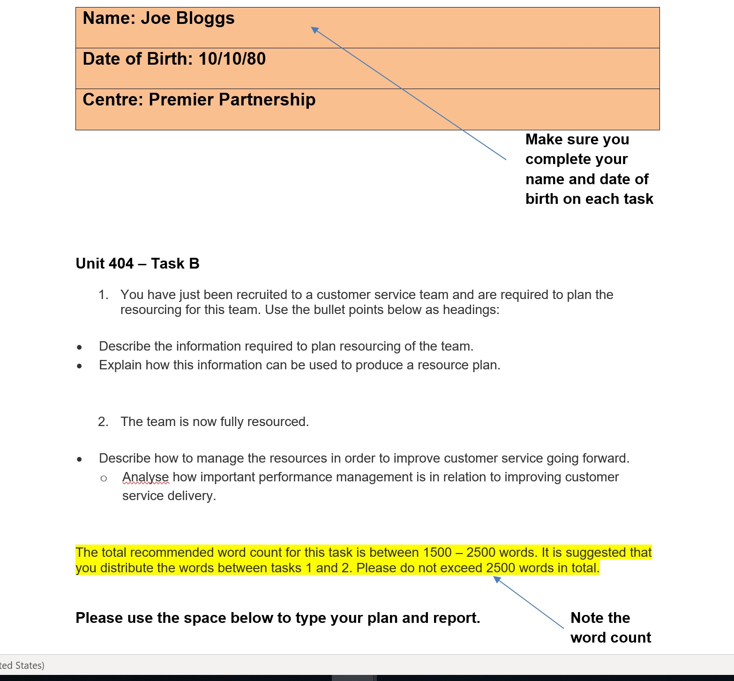
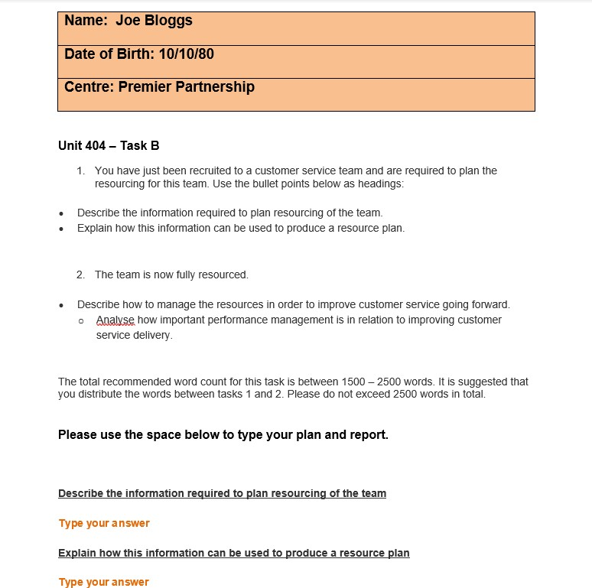
In order to make sure you include all the key points in your assignment use the bullet points as your headings. This will also make your work easier for your assessor to mark. Proof -read your work before submission, using the Assessment Criteria as a check list to make sure you’ve covered all the key points.
For Level 5 and above– you will need to enter your name and CMI candidate number

Slide 30
Referencing
Referencing is an important part of academic work. It puts your work in context, demonstrates the breadth and depth of your research, and acknowledges other people’s work. You should reference whenever you use someone else’s idea.
To avoid a referral its important to reference your work correctly. We suggest you use the
Harvard system for referencing as it’s the most commonly one used.
Also include a bibliography when referencing your work:
A bibliography is the term used for a list of sources (e.g. books, articles, websites) used to write an assignment (e.g. an essay). It usually includes all the sources consulted even if they are not directly cited (referred to) in the assignment.
How to write a Bibliography Harvard style: Harvard in-text referencing – Anglia Ruskin University Referencing: the why & how– University of Leeds

Slide 31
If you’re a more visual learner, then you may prefer to Google a particular topic or watch a Ted Talk rather than the suggested e-learnings, which is absolutely fine. However, please don’t be tempted to copy and paste text from Google as this would be considered as Plagiarism.
Plagiarism: “presenting someone else’s work, in whole or in part, as your own. Work means any intellectual output, and typically includes text, data, images, sound or performance”. (University of Leeds, 2017)
Before you start your qualification, it is important that you fully understand what plagiarism is and the techniques you can use to avoid plagiarizing in the first place. For units with written assignments you will be asked to submit a statement of authenticity confirming that the work you are submitting is your own. When you submit any work (including exam papers) electronically you are also declaring that the work is authentic and is your own.
In cases where plagiarism is identified these will be investigated further by Premier Partnership and City & Guilds, and may result in you being disqualified from the qualification itself and any future qualification with the awarding body. Plagiarism and malpractice will not be tolerated and any incidents will also be reported to your department and may result in disciplinary action.
Please visit The University of Leeds – Academic Integrity & Plagiarism page before starting your qualification and familiarize yourself with the information available. We would also recommend completing the You Be the Judge activity and Recognising Plagiarism to test your understanding.
If you are unsure what constitutes plagiarism, or would like to discuss this further, please don’t hesitate to contact the ODP Central Team (learningandaccreditationteam.centralodp@hmrc.gov.uk).

Slide 32
How to upload a task

Slide 33
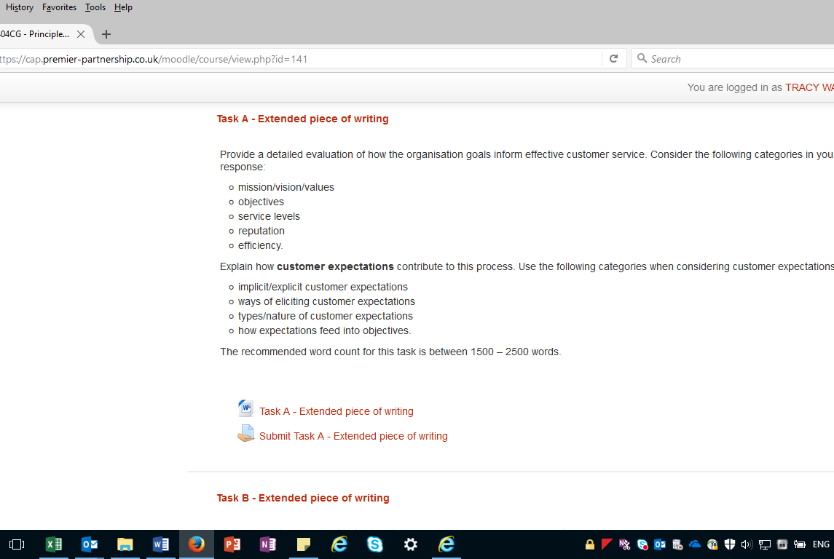
Step 1 click on submit task button below

Slide 34
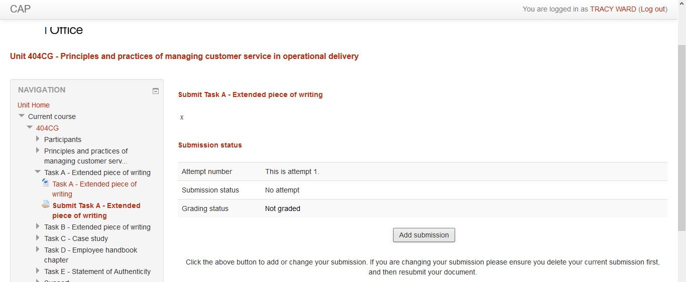
Step 2 click on add submission button

Slide 35
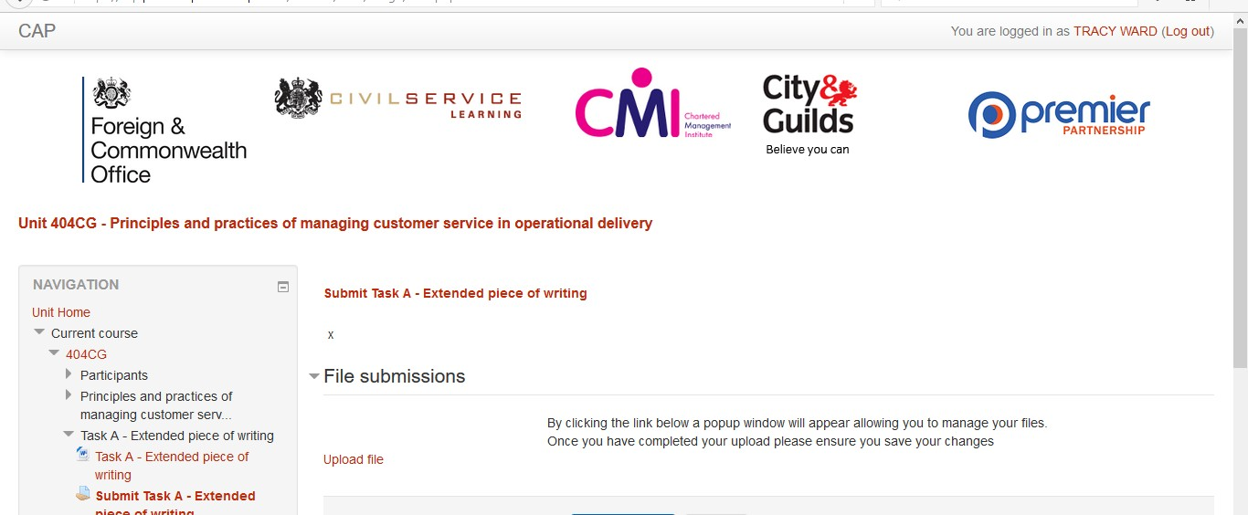
Step 3 click on upload file

Slide 36
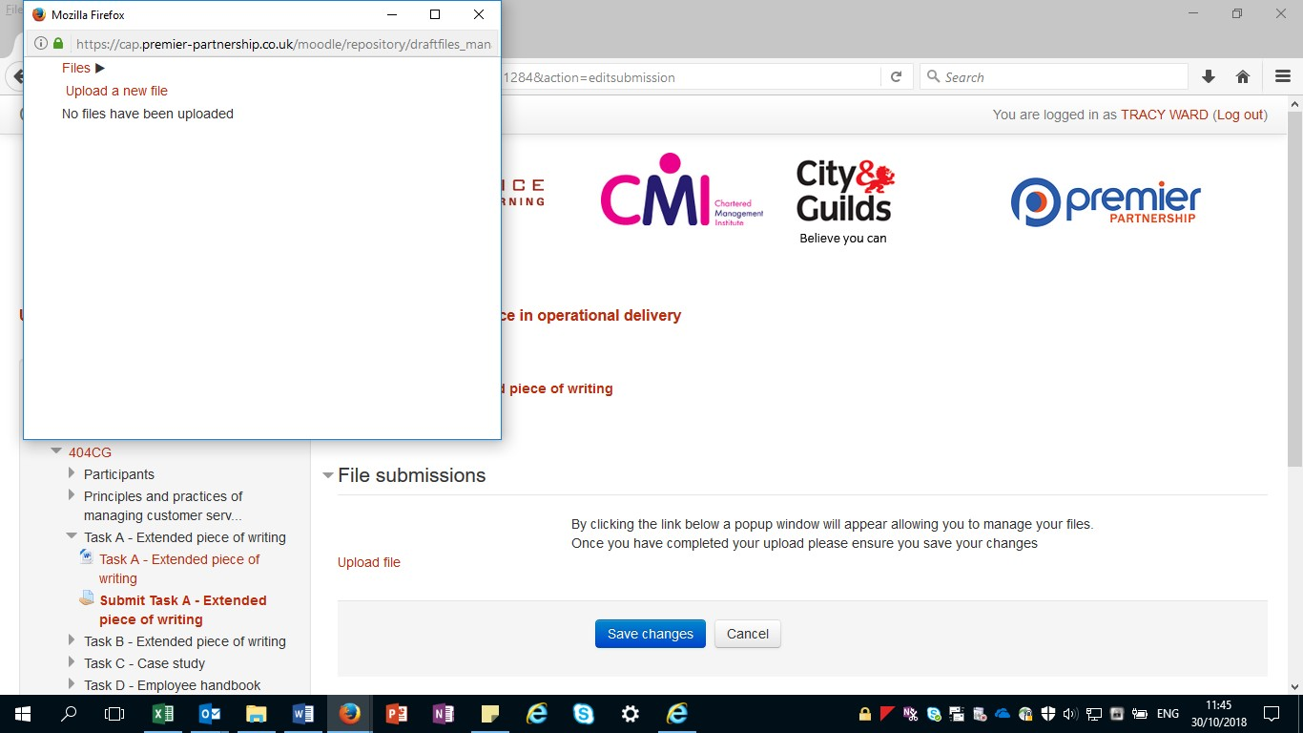
Step 4 click on upload a new file

Slide 37
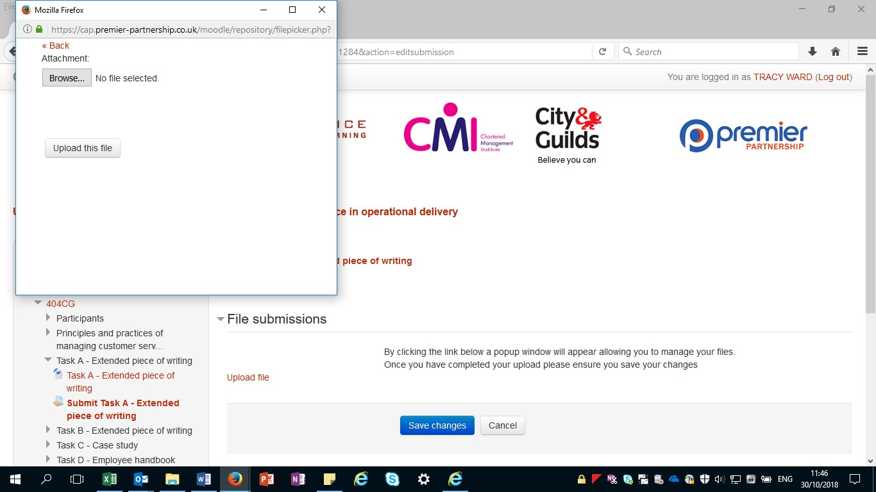
Step 5
Click on browse to find your word document for this task and upload file and then save changes

Slide 38
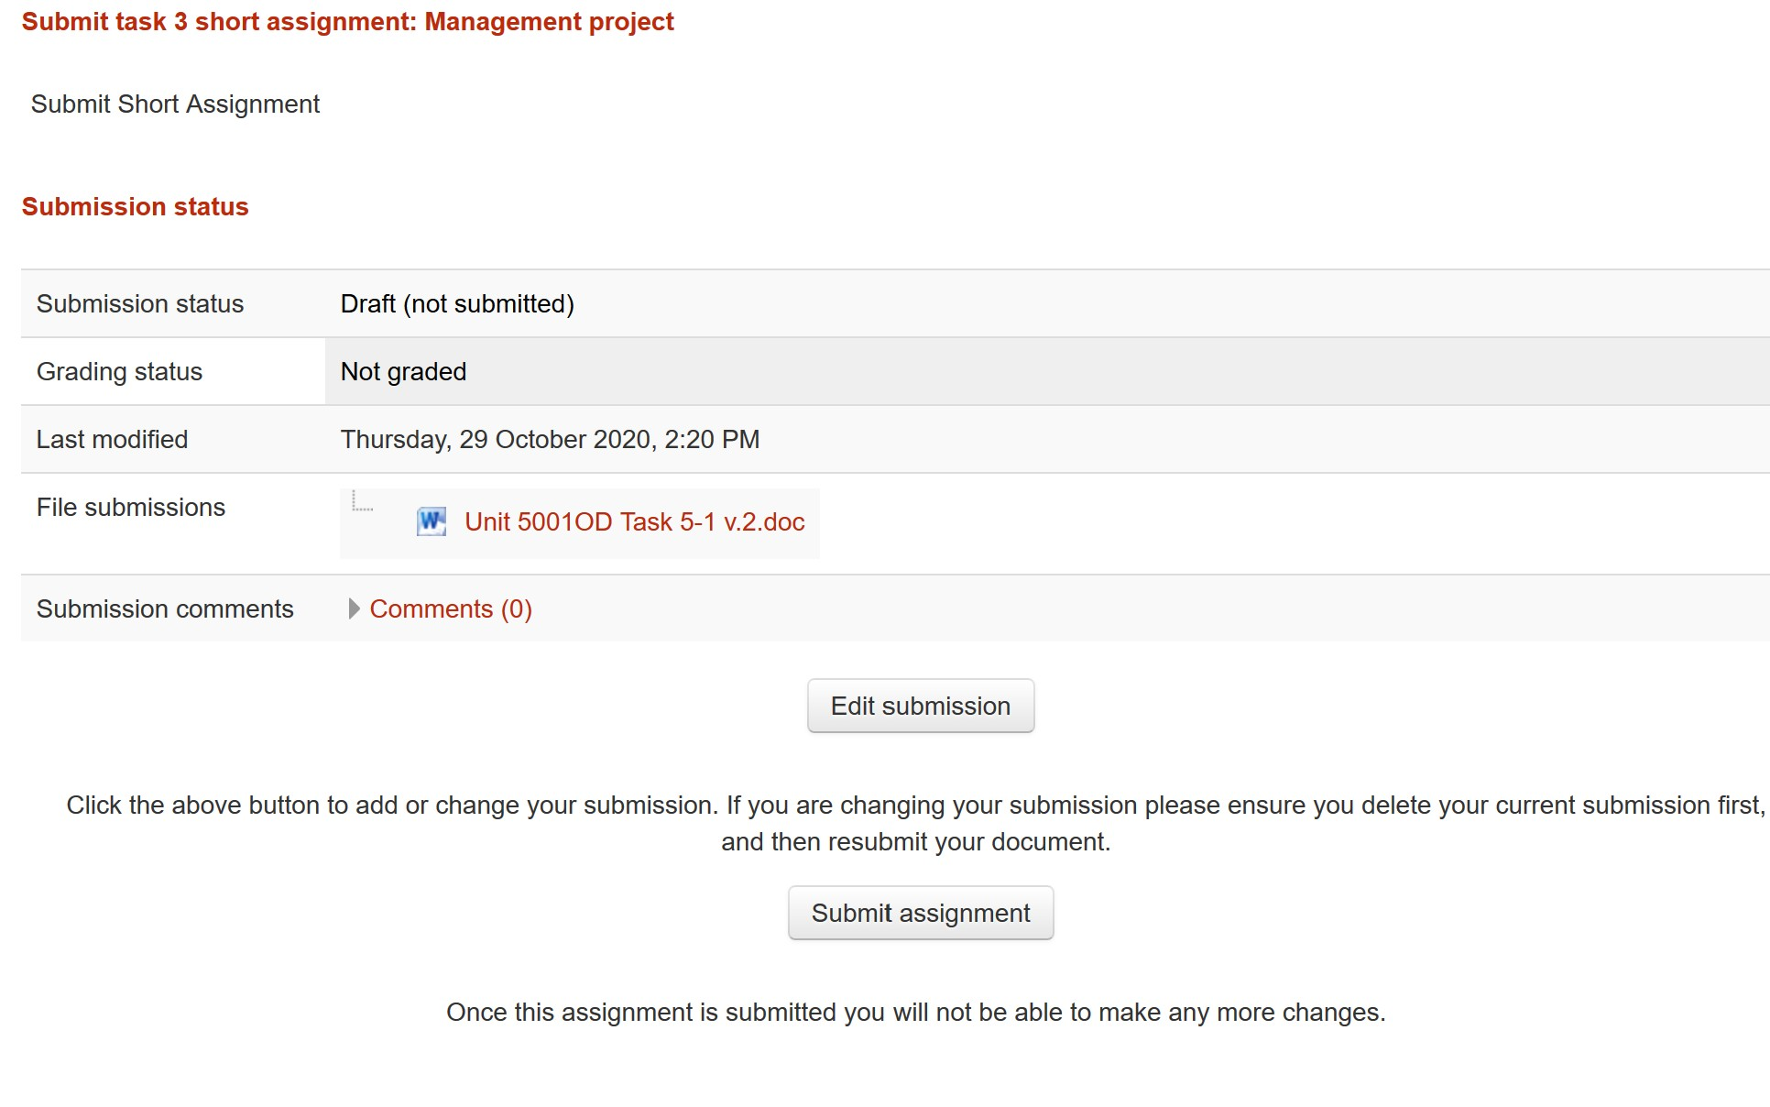
Step 6
Finally don’t forget to click submit assignment
Remember: Your work will only be marked once all the tasks for that unit have been completed and submitted – once you have submitted a task, no changes can be made

Slide 39
How to upload a revised document following a referral
To amend your task submission and resubmit for remarking please see the guidance below:
Using the assessors feedback you need to amend your task document accordingly. You can do this by using the original document you saved to your computer or you can download the original submitted document from the submit task section on Premiers Website
Once you have made your amendments save the document to your own computer

Slide 40
Click upload file

Slide 41
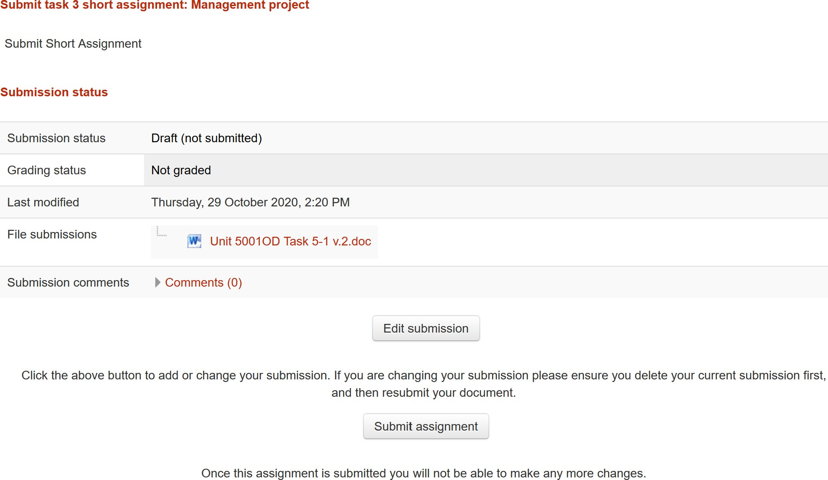
You now need to go to the submit task section of the unit and click edit submission

Slide 42
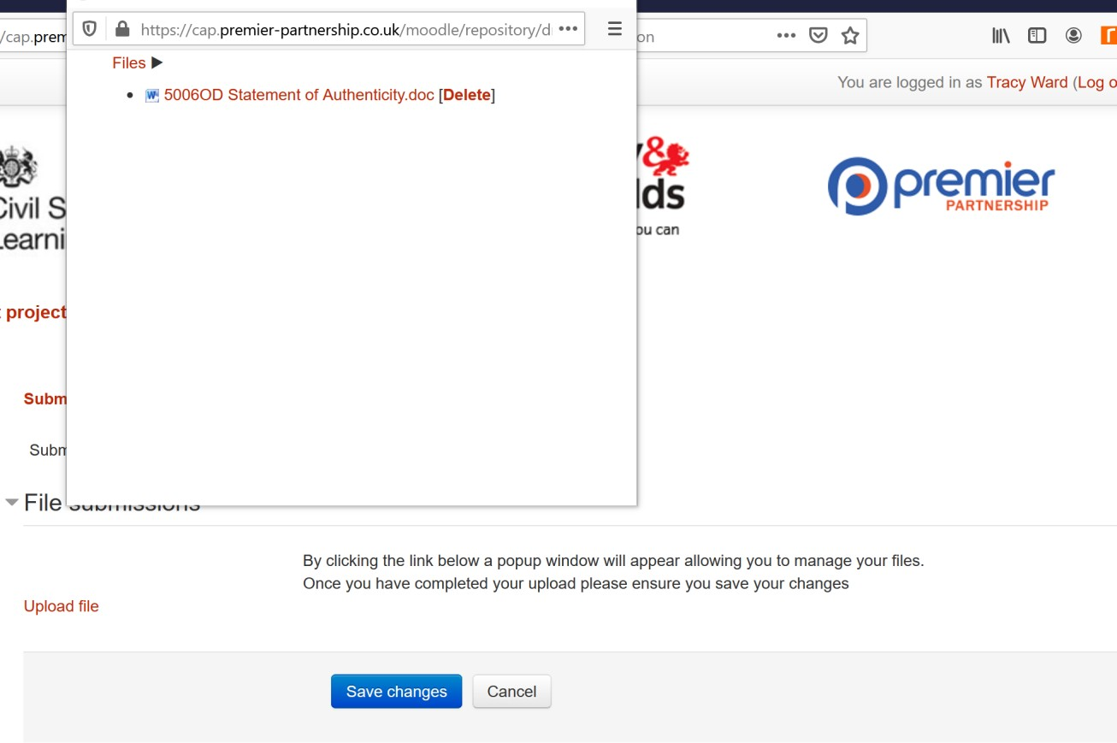
The file that is already attached will appear You need to delete this
Version .4 - June 2021
OFFICIAL

Slide 43
The browse option will appear for you to select and attach your revised document from your own computer

Slide 44
Once your revised document is attached make sure you click upload this file, and save changes

Slide 45
Finally submit the assignment

Slide 46
Submission Checklist for Online Tests
Read all the questions carefully.
Try and give an answer to every question.
Remember all the questions carry different marks, if you are struggling with a question worth 1 mark, move on and come back to it later, as there may be a question further along worth 3 marks that you can answer.
At the start of the exam, ask your invigilator to keep a check of the time and remind you at regular intervals how much time you have left, it’s amazing how quickly the time goes and you’re too busy to notice.
If you finish early and have spare time, read through your answers again to see if you can improve on what you have written. Check that you have not missed any questions.
Top Tip ……..Keep calm, if you’re feeling a bit nervous, take a deep breath and don’t start your exam until you feel composed and ready.
Once you start you will be in exam conditions, so this means you won’t be able to take a break half way through or ask any questions at this stage
Reasonable adjustments can be considered so please make sure you discuss this with your line manager and training provider ahead of booking your exam.

Slide 47
Submission Checklist for Assignments
Remember your assignments won’t be marked until all tasks for that unit are completed and submitted.
Before submitting your work:
Have you entered your name and date of birth on each task?
Is all your work correctly referenced?
Have you signed and dated the statement of authenticity?
Have you met the word count for the appropriate tasks?
Finally, have you proof read your work and covered all the points within
the Assessment Criteria?
TOP TIP…….. Cross reference the Assessment Criteria against your tasks, use it as a tick list to ensure all key points are covered in your assignment

Slide 48
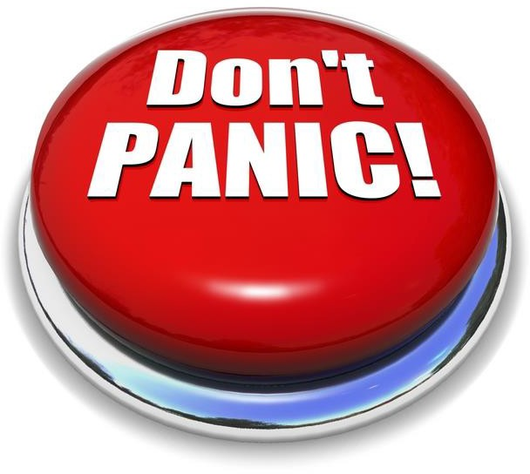
Re-sits and Referrals
If you need to re-sit a unit test (Levels 2-4)
Don’t worry,
Level 2 re-sits only are non-chargeable and can be booked direct on the Moodle platform.
Levels 3 and 4 re-sits are chargeable and must be booked by emailing the ODP, Team (HR) who will submit a booking form and ensure this is paid in advance which will then allow you to book the re-sit on the Moodle platform.
You will receive a different version of your test for your re-sit.
So, you’ve received a referral (Levels 5-7)
Don’t worry your assessor will explain exactly what information or further work is needed to strengthen your assignment to successfully pass.
Read the referral carefully and ensure you deal with all the points raised before re-submitting your work.
Remember: Its ok to go back to the assessor if you need further clarification on the referral, they are not the enemy! They want you to pass the task as much as you do.
The assessor will only be able to read your comments once you have resubmitted your work. So, if you would like to speak to an assessor before you resubmit your work you will need to email quals@premier-partnership.co.uk

Slide 49
Support Available
You’re not alone, there is lots of support available to help you complete your qualification:
Premier Partnership Website
Lots of useful information and how to guides on their website, as well as helpful resource and referencing materials.
ODP Website
Our ODP website contains all the information you need regarding the profession, including details of our qualification/learning offer. You'll need to complete the registration details to access the website, if you have not already done so.
Operational Delivery ODP Website Learning Page:
Includes a free on-line resource library to help with those unit tasks, as well as recommended learning for each of your qualification units. You'll need to be registered on our ODP website to access the information.
Buddy Scheme:
For extra support, why not sign up to the Buddy Scheme, where you will be paired with someone who has previously complete the same qualification. You'll need to be registered on our ODP website to access the information.
Line Manager Support
Your line manager will be able to offer some support with your qualification as they will also have access to the learning website, known as the Moodle site. Make sure you discuss the progress made with your qualification in your 1 to 1 conversations.

